Slide 1


PS 39: Text-Based Adventure Game
Rungta International Skills University
Submitted By
Submitted To
Shoaib Akhtar
Mr. Priyanshu
ERP: RU-26-00647
IBM SME
B.Tech. 1st Sem IBM
Notes:
Introduce yourself, the project (PS 39, Text-Based Adventure Game in Python 3) and your guide, Mr. Priyanshu.

Slide 2



Introduction
A console adventure game written in Python 3. The player starts in the Forest, chooses where to go from a menu, survives random monster attacks and collects score until they quit or lose all health.
It brings the core ideas of the course together in one small, fully tested program: conditions, loops, functions and the random module.
Forest
Where the game starts. Choose where to go.
Cave
A monster attacks. Survive and find a key (+20).
3
1
13
River
places to explore
Python file, no extra libraries
automated unit tests
A treasure is waiting (+50 score).
Notes:
Explain the idea in one breath: forest start, cave with a monster, river with treasure. Mention that the program uses only the Python standard library and has 13 automated tests.

Slide 3

Project Description & Problem Statement
PROBLEM STATEMENT
BARE MINIMUM REQUIREMENTS
Create a text-based adventure game in which the player explores a forest, a cave and a river by choosing options from a menu, faces a random monster attack, collects score and ends the game by quitting or losing all health.
One Python 3 file, run from the console
Functions for each place, conditions for the choices
Cave Monster attacks (random damage 10 to 40). If the player survives: key, +20 score.
A loop that runs until the player quits or Health is 0
1
River A treasure gives +50 score.
random module for damage; track Health and Score
2
Validate every menu choice and show the final score
3
Quit Leave the adventure and show the final score.
Start: Health 100, Score 0, in the Forest
Notes:
Read the problem statement briefly, then walk through the three menu options and the five bare minimum requirements. Say that all five are met.

Slide 4







Technology & Tools Used
TOOLS
Python 3.8+
random
unittest
Git + GitHub
Programming language
Monster damage with randint(10, 40)
13 automated tests
Version control and automatic test runs
CONCEPTS USED
Conditions
Loops
Functions
Random
if / elif / else choose the action and check survival
while health > 0 runs the game; the menu repeats on bad input
forest(), cave(), river() and play_game()
random.randint(10, 40) gives the monster damage
Notes:
Only the Python standard library is used. unittest runs 13 tests, and GitHub Actions runs them automatically on every push.

Slide 5
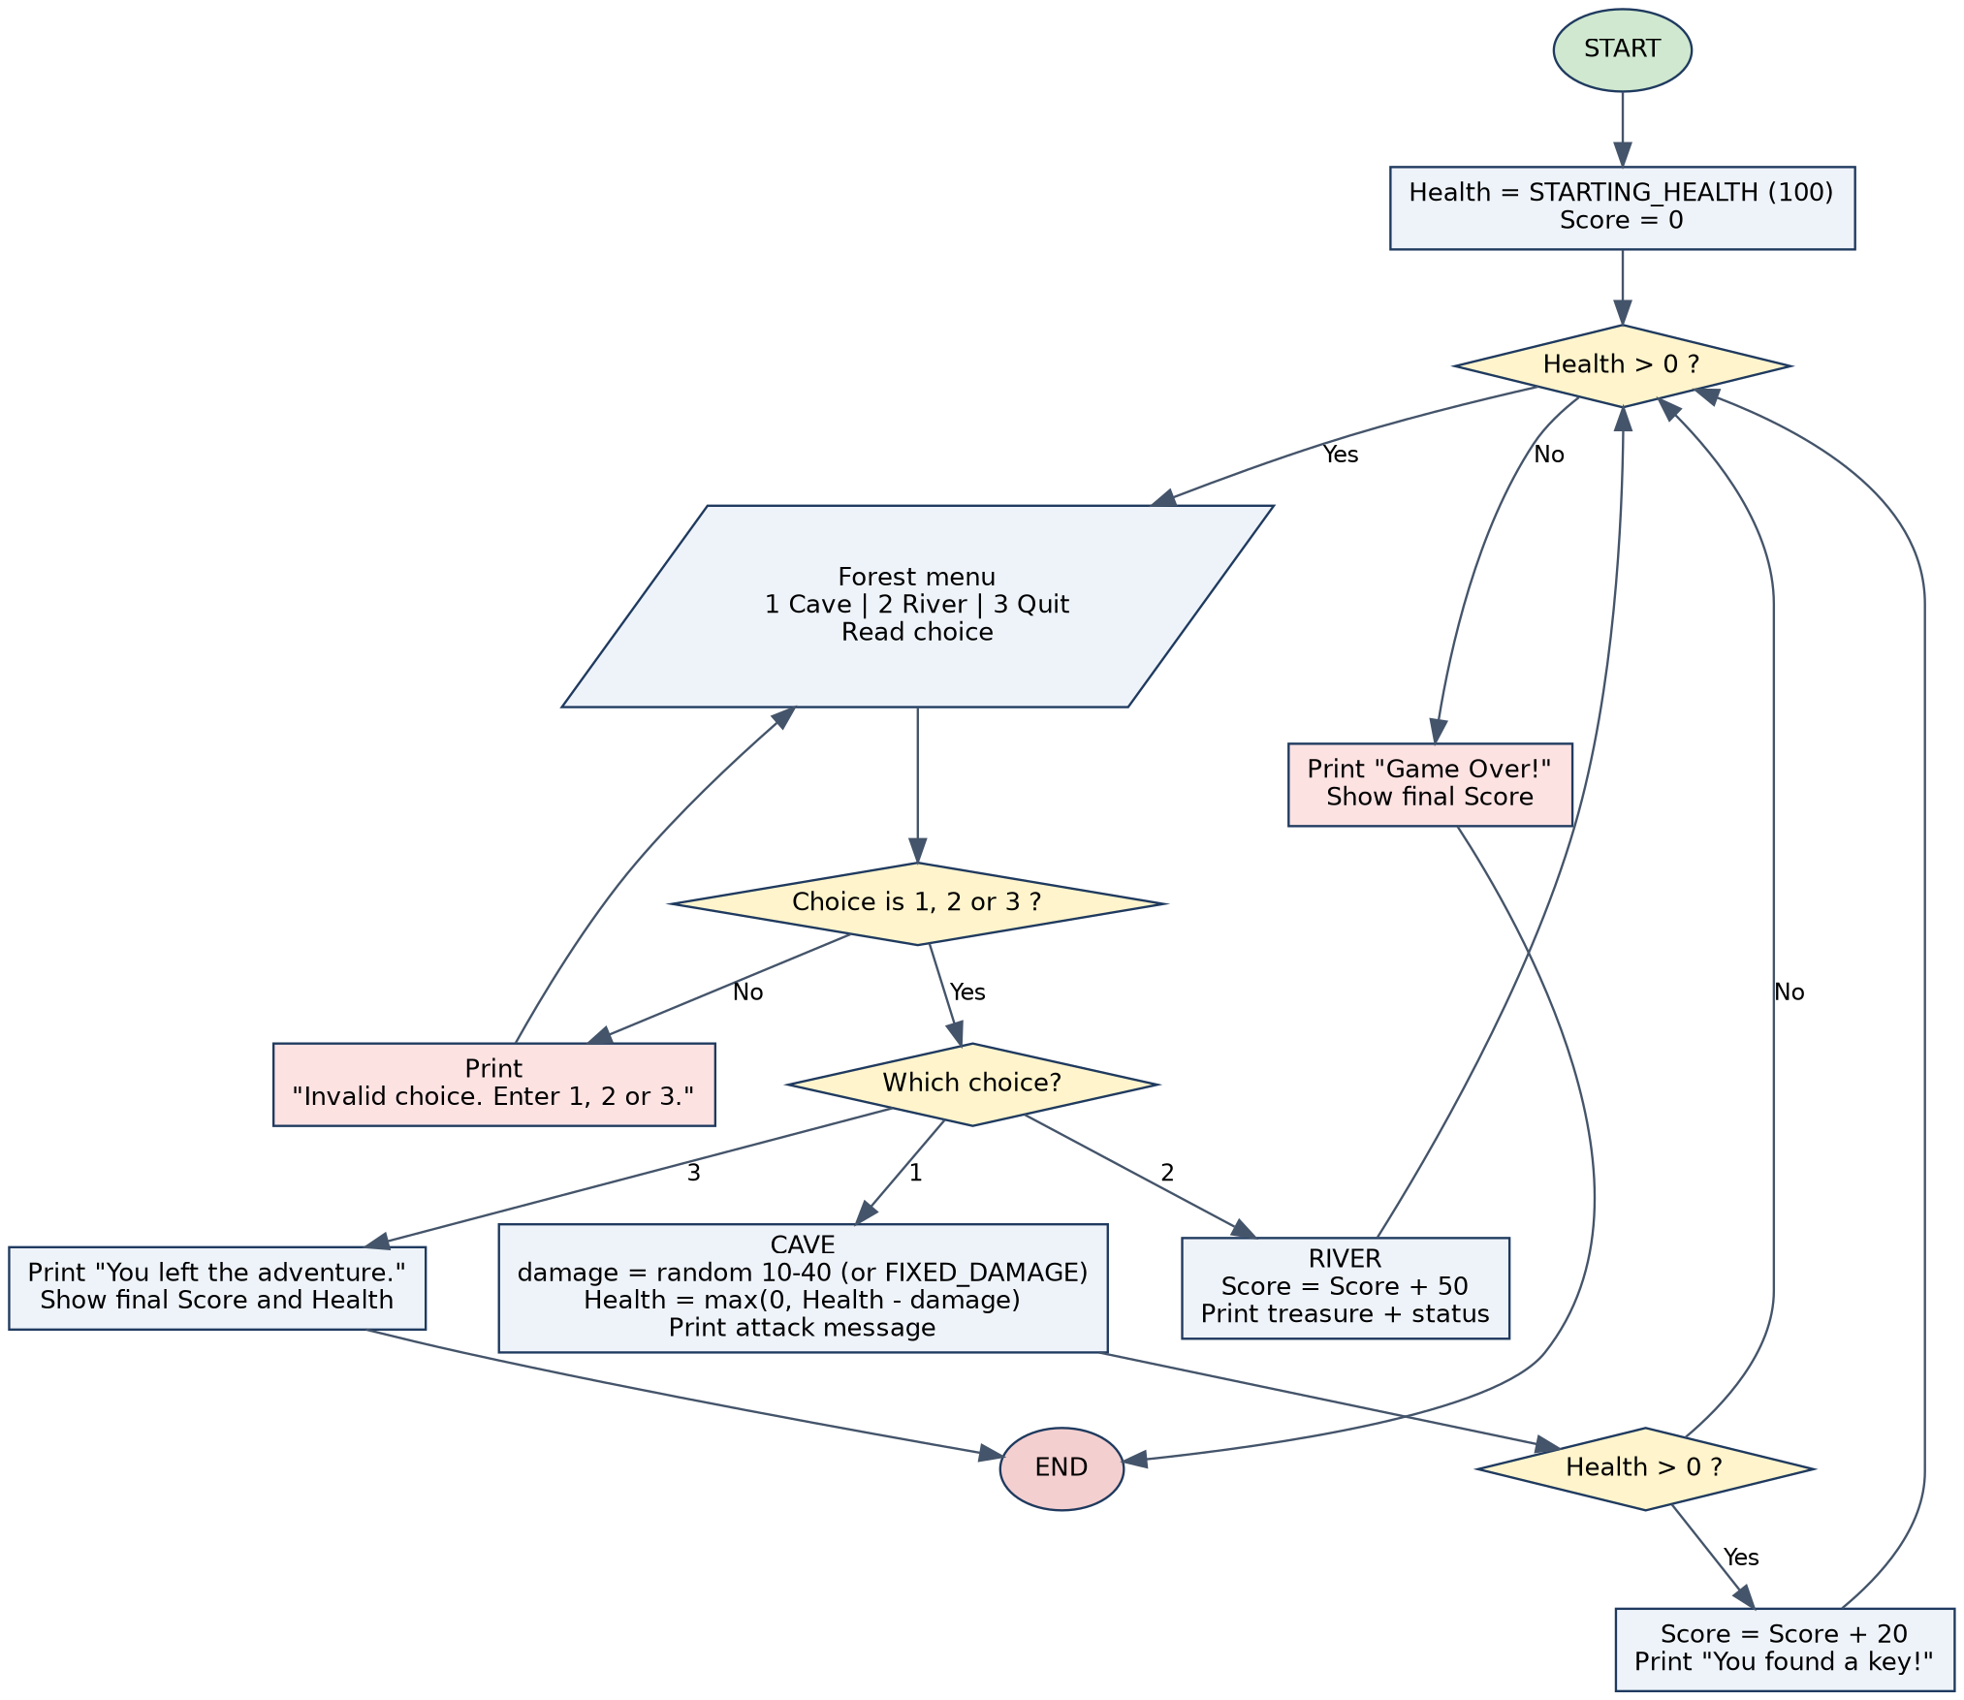
Working of the Project
1
Start Health 100 and Score 0 in the Forest.
2
Menu Show the menu and check the choice is 1, 2 or 3. Wrong input: ask again, no health lost.
3
Cave Random damage 10 to 40. If Health is still above 0: key, +20 score.
4
River Treasure, +50 score.
5
End Quit or Health 0: show the final score.
Notes:
Follow the flowchart: the loop runs while Health is above 0; the menu is validated; the cave reduces health with max(0, health - damage); the game ends on Quit or Game Over with the final score.

Slide 6
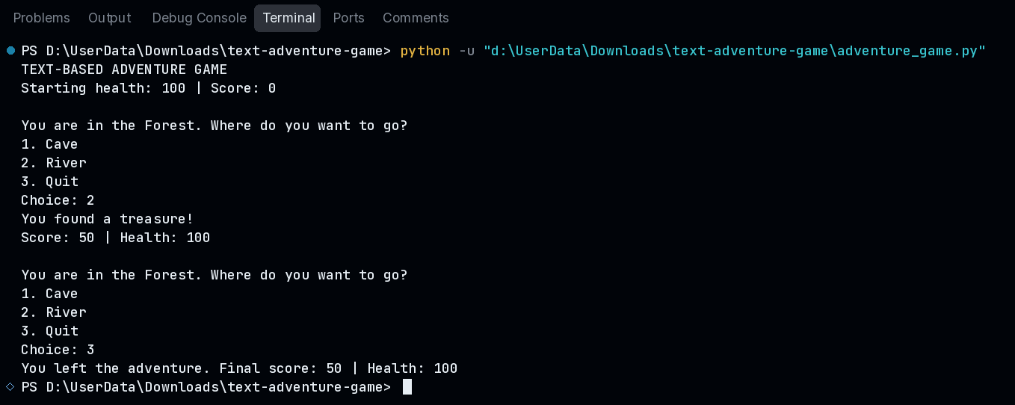
Project Screenshots: Test Case 1
PASS
Normal input. Choice 2 (River), then 3 (Quit). Treasure found: Score: 50 | Health: 100.
Notes:
Test Case 1 (Normal input). Real console output of adventure_game.py in the VS Code terminal. Choice 2 (River), then 3 (Quit). Treasure found: Score: 50 | Health: 100.

Slide 7
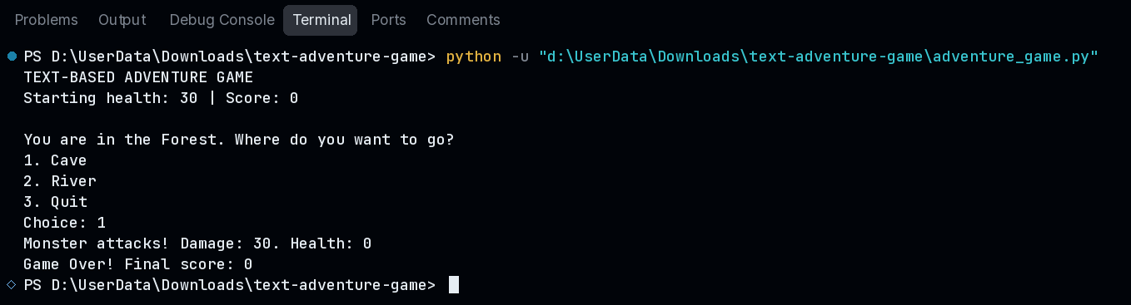
Project Screenshots: Test Case 2
PASS
Boundary / minimum input. Starting Health 30, damage fixed to 30, Choice 1 (Cave). Health 0 and Game Over, final score 0.

Slide 8
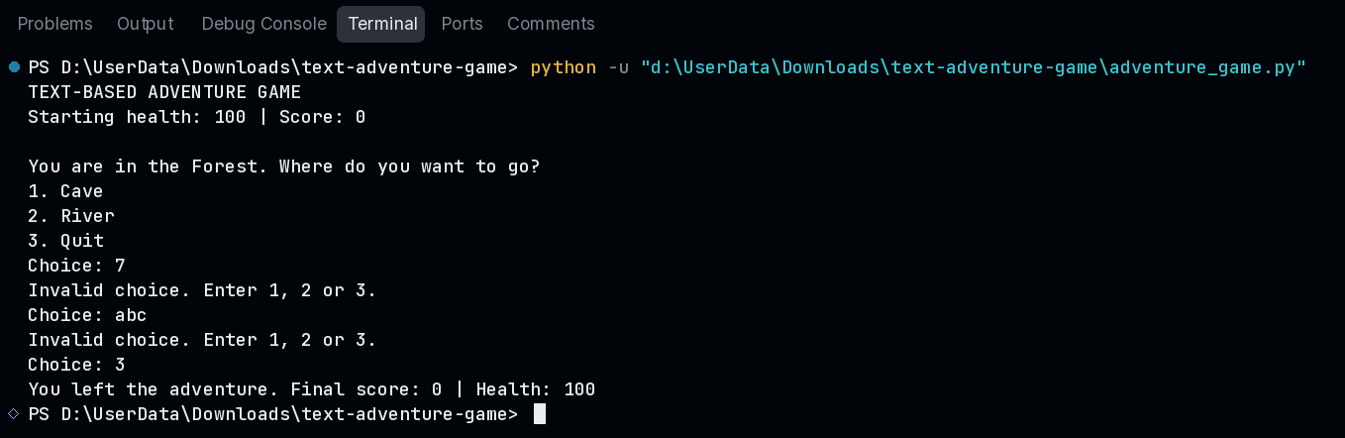
Project Screenshots: Test Case 3
PASS
Invalid input. Choices 7 and abc are rejected with "Invalid choice. Enter 1, 2 or 3." and no health is lost.

Slide 9
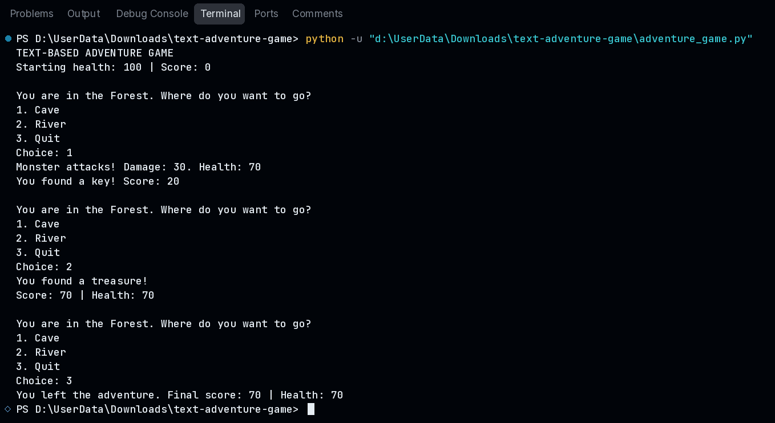
Project Screenshots: Test Case 4
PASS
Different valid scenario. Damage fixed to 30. Cave, River, Quit: final score 70 and Health 70.

Slide 10
Thank You
Source code, tests and report: GitHub repository: text-adventure-game

